Slide 1
Week 12 Mixed Models

Slide 2
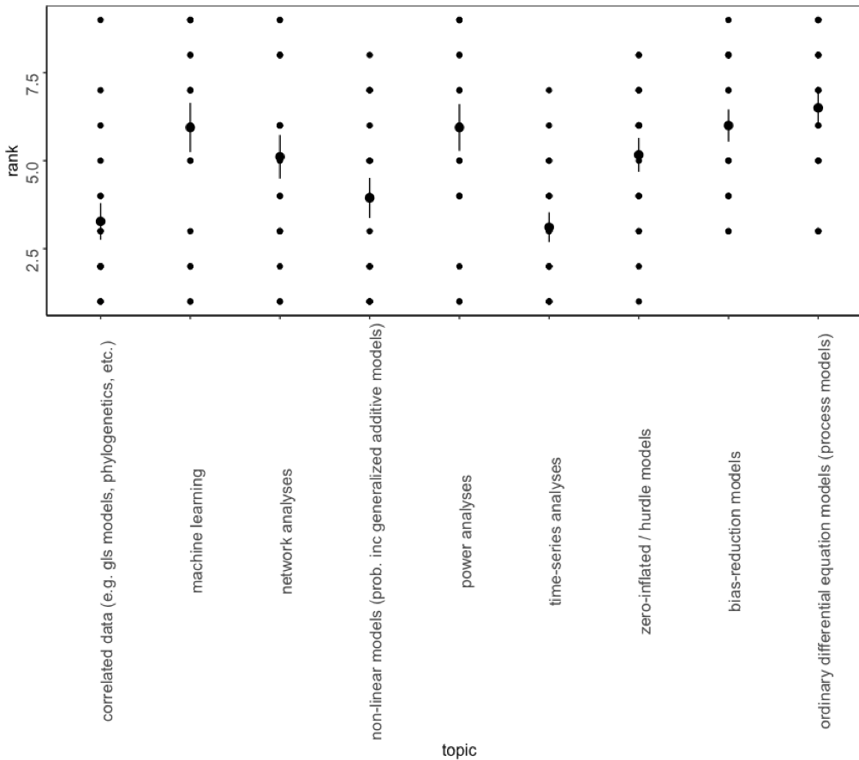
Survey

Slide 3
Goals
Understand the differences between fixed and random effects
Introduce mixed models and how to use them
Run mixed models in R

Slide 4
Mixed models optional reading
If you are using Mixed Models in the future, I highly recommend the TREE paper posted
Generalized linear mixed models: a practical guide for ecology and evolution
Technical details (R fitting and packages) are a bit out of date but background is still relevant

Slide 5
Background
We often have block effects (e.g. pseudoreplication) that we need to account for
What is pseudoreplication?
Identifying the ways in which are individual points are correlated, and how we need to consider these can be difficult.
Sometimes we want to account for this variability, but we don’t really care about estimating a specific effect

Slide 6
Mixed models
Mixed models are models which combine “random” and “fixed” effects.
Fixed effects are effects whose parameters we wish to estimate
Examples?
Random effects are effects that we wish to account for without estimating individually
Site
Village of residence
Plot

Slide 7
Classical approaches to mixed models
The classic approach to mixed models involves fitting regular linear models, but interpreting the “sums of squares” differently.
Decompose sums of squares
Decide which error terms to put in the denominator, which in the numerator, how many degrees of freedom
Classic approaches will not work well if you have
strongly unbalanced designs
responses that you’d rather treat with a GLM(M) (e.g., binary responses)

Slide 8
Modern and classical approaches
“Modern” approach to mixed models involves explicitly estimating “random” parameters and their variances.
Compared to the classic approach to mixed models, the modern approach is:
conceptually clear
flexible
powerful
computationally difficult

Slide 9
Example
Testing the effects of acid rain on spruce tree growth.
We have a complex manipulation (what kind of air the trees are exposed to). As a result:
We have a small number of trees
We take a lot of samples from each tree
“Treatment” is a fixed effect
We want to estimate the difference in growth with clean air and dirty air
“Tree” is a random effect
We want to know what about the distribution of tree effects (so we can control for it); we are not specifically interested in the difference in growth between tree 3 and tree 5

Slide 10
Random effects
Random effects are typically based on unordered factors
the levels of the factor are conceptualized as random samples from a larger population
the effect of each level is therefore a random variable
the essential parameters we estimate are not the effect of each level, but the mean and variance of the distribution.

Slide 11
Is this a random effect?
Treating something as a random effect means treating the levels as interchangeable from the point of view of your scientific hypothesis.
There is sometimes controversy about when it is appropriate to model a predictor using random effects.

Slide 12
Philosophical questions on random effects
are the levels chosen from a larger population?
are the levels chosen randomly?
are the levels a non-exhaustive sample of possible levels?
do you want to be able to make predictions about new (unobserved) levels?
or inferences that include them?
are you interested in the distribution of levels/variability among levels?
are you uninterested in testing hypotheses about specific levels?

Slide 13
Types of analysis
There are several terms that are often used as synonyms for mixed models
repeated measures
individual identity would typically be associated with a random effect

Slide 14
Types of analysis
multilevel or hierarchical models
each identifiable level could have its own random effect: e.g., country, village, household

Slide 15
Inferential questions
The choice to make something a random effect often has more effect on your inferences about other variables than on your inferences about the focal variable
Inferring using a fixed effect means we are inferring across the group of levels we have measured (only)
Inferring using a random effect means we are inferring across a population represented by the group of levels we have measured

Slide 16
Influenza example
We measure effects of an influenza vaccination experiment for several years
Year as a fixed effect: did vaccination “help” on average over these years (with a particular set of flu strains, etc.)
Year as random effect: will vaccination “help” on average over a wider set of years (assuming observed years are representative).Note – year is not continuous in this case. It is treated as a factor.

Slide 17
Example
You performed an experiment where you wanted to understand the effects of infection on the microbiome diversity of honeybees. You performed experimentally infected individual bees from 8 hives and took 3 microbe samples from each individual before treatment and 3 microbiome samples from each individual after treatment. You sampled 20 bees per hive (the same 20 at each sampling time point).
You want to know whether infection influences bee microbiomes.
What are you fixed effects?
What are your random effects?
What distribution might you use?

Slide 18
Example
You collected data on bear movement behavior by GPS collaring 64 individual bears. You want to know how abundance of specific foods influences how far a bear moves. For each bear, you have 120 daily GPS measurements.
What are the fixed effects?
What are the random effects?
What distribution might you use?

Slide 19
Example
You want to understand how flow rates of different rivers influence the amount of nutrients in each river. You set up 8 sampling stations along 6 rivers where you measure flow rate and nutrients.
What does your model look like?
What are you fixed effects?
What are your random effects?
What distribution would you use?

Slide 20
Identify the fixed and random effects in these examples
You measure stress hormones in 20 individuals each in 10 troops of baboons. You want to know whether sex and age affect hormone levels.
You want to examine the effect of temperature on crayfish growth in 25 water bodies in 3 counties.
You want to examine how wildmeat consumption varies among individuals given their age. You collect data from 40 different households of 2-8 individuals each.

Slide 21
Practical questions
Modern methods
have you measured a sufficient number of levels to estimate a variance (>4, preferably >10)?
May need more for more complicated models
Classic methods
Do you have a balanced design?
Otherwise
Limit your inference (experiment vs more broadly)
Try an even more advanced approach (usually Bayesian)

Slide 22
Fitting
Modern mixed-model packages can fit a wide variety of models. You just need to specify which effects are random.
Works with unbalanced designs
Works with crossed random effects
May require a lot of data (and sometimes a lot of levels) for a reliable fit
Depends on model complexity

Slide 23
Too few levels
If you have something that should be a random-effect predictor, but you don’t have enough levels, you can’t fit a mixed model
It’s OK to treat your random effect as a fixed effect, as long as this is properly reflected in your scientific conclusions.
The scope of your analysis covers only the sampled levels, not the population they were sampled from

Slide 24
How it works
It’s complicated!

Slide 25
How it works
typically based on marginal likelihood: probability of observing outcomes.
Balance (dispersion of random effects around 0) with (dispersion of data conditional on random effect)
Shrinkage: estimated values get “shrunk” toward the overall mean, especially in small-sample/extreme units

Slide 26
Practical details in R
lme (nlme package): older, better documented, more stable, complex variance structures, gives denominator df/p values
(g)lmer (lme4 package): newer, faster, does crossed random effects, GLMMs
glmmTMB: newest, can fit zero-inflated random effects models, https://cran.r-project.org/web/packages/glmmTMB/index.html
https://journal.r-project.org/archive/2017/RJ-2017-066/RJ-2017-066.pdf
many other special-purpose packages
We will primarily use lme4
https://bbolker.github.io/mixedmodels-misc/glmmFAQ.html

Slide 27
Nested experimental designs
Nested designs are inherently hierarchical
Each pupil belongs to a class and school
In lme4, this would be (1|School/Class)

Slide 28
Crossed experimental designs
In crossed designs, all levels belong to more than one level of an upper variable
E.g students in class 1, go to school 1, 2, and 3
We would specify this in lme4: (1|School) + (1|Class)

Slide 29
Crossed experimental designs
Another example
Imagine you have repeated replicates of sites that were randomly selected and every bird you sampled was also color banded which was randomly assigned (e.g. not only blue bands at Pandapas Pond)
You could specify that in lme4: (1|Site) + (1|ColorBand)

Slide 30
Random intercepts vs random slopes
The simplest version is to think of your random effects as only random intercepts
But occasionally, we will also have random slopes
We wanted to understand how infection changed over date, measured at 25 sites
It is logical to include site – but what about date?
We want to know how infection changes with date so we care about that
But we were also concerned that the random variation across sites might differ by date.
As date changes, so might the distribution of data across sites
We modeled this is inf ~ date + (date|site) which allowed both the intercept and slope to be random effects

Slide 31
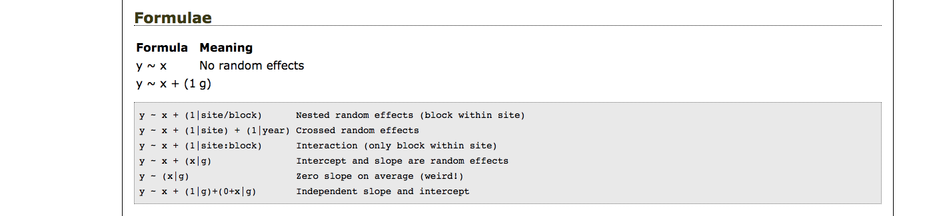
Coding random effects

Slide 32
Remember parsimony
Although you may have any number of potential structures of random effects, remember the simplest one will include just random intercepts

Slide 33
A note about predicting random effects
When you predict a model with random effects, you will likely want to ‘drop’ them (e.g. integrate over them)
In lme4, the syntax is predict(mm1, re.form = NA).

Slide 34
Digging deeper
Bolker book chapter: http://bbolker.github.io/mixedmodels-misc/ecostats_chap.html
https://bbolker.github.io/mixedmodels-misc/glmmFAQ.html
TREE Paper on canvas (in folder)

Slide 35
Go to R..

